Slide 1
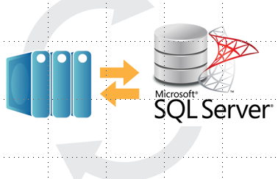

A Database Backup Is Useless If You Can't Restore It
Joe Gavin
Notes:
Get out from behind podium and move around (in–person)
Turn camera off after starting (virtual)
Start off with ‘Hi I’m Joe Gavin. Start off with an engaging story to pull audience in ie ‘Why should I listen to you?’
We
Backup our databases
Get alerts if there is a failure
Can physically see the files
But do we really know if all our backups are good? The only way to really be sure if our database backup files are restorable is to actually restore them.
After story mention how you want questions, ie throw them out or in chat (virtual)
Mention slides will be available

Slide 2









Thank You! Sponsors

Slide 3
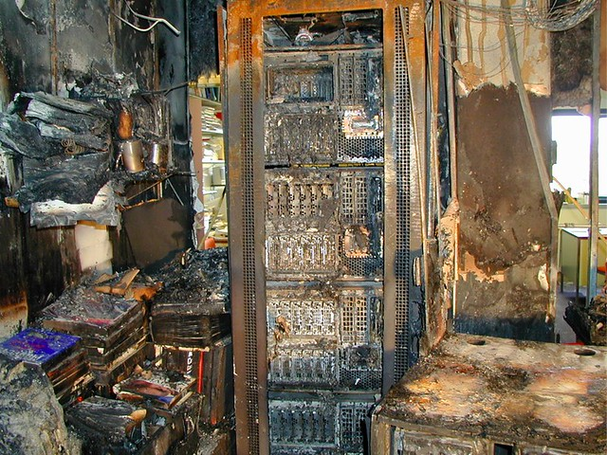
Database Restore Failure
What are the repercussions of not being able to restore a backup?
Lost $$$
Lost confidence
Lost employment?
Notes:
This reiterates why backups need to be stored in another physical location
Fires happen
Physical locations are destroyed
Hardware fails aren’t the only reason a database is restored
Database corruption
Data accidentally deleted ie WHERE clause left out

Slide 4

Verify your backups - NOW!
https://www.red-gate.com/products/dba/sql-backup/resources/verify-backups-now
Notes:
- Watch this video if I haven’t scared you enough

Slide 5
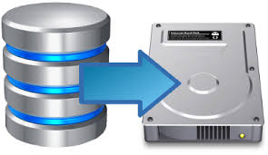
Agenda
Recovery models
Backup types
dbatools
Backing up databases
Testing backups by restoring them
Automating restore testing

Slide 6
Database Recovery Models
Full
Recoverability to an arbitrary point in time
Transaction Log Backups are required
Simple
Transaction Log cannot be backed up
Transaction Log is truncated on checkpoint

Slide 7
Types of Database Backups
Full
Entire database
Foundation for Differential and Transaction Log restores
Transaction Log
Serial backup of all transactions since the last transaction log backup
Differential
Changes made since the last full backup
Notes:
- Questions?

Slide 8
RPO / RTO
Recovery Point Objective (RPO)
Amount of data (measured in time) that the business can afford to lose
Recovery Time Objective (RTO)
Time from the beginning of the outage to the time the everything is operational again
Notes:
Add here

Slide 9
Database Backups
12A Full
4A Log
12P Diff
2P Log
4P Log
6A Log
6P Log
8P Log
10P Log
8A Log
10A Log
2A Log

Slide 10
Database Failure at 9:00 AM
12A Full
4A Log
12P Diff
2P Log
4P Log
6A Log
6P Log
8P Log
10P Log
8A Log
10A Log
2A Log
9A Fail

Slide 11
Database Failure at 5:00 PM
12A Full
4A Log
12P Diff
2P Log
4P Log
6A Log
6P Log
8P Log
10P Log
8A Log
10A Log
2A Log
5P Fail

Slide 12
Test Restores at 11:00 PM
12A Full
4A Log
12P Diff
2P Log
4P Log
6A Log
6P Log
8P Log
10P Log
8A Log
10A Log
2A Log
11P Test
Notes:
- Questions?

Slide 13





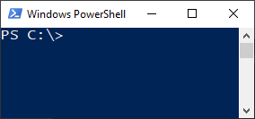
dbatools
dbatools.io
Notes:
- dbatools is a set of 500+ open-source PowerShell scripts that is essentially a command line Management Studio
- I became a firm believer when I had to migrate 150+ SQL Agent jobs from an existing SSIS server to a new server so had to be able to recreate, leave enabled on existing, and disable on new
- dbatools.io has installation, help on each command

Slide 14
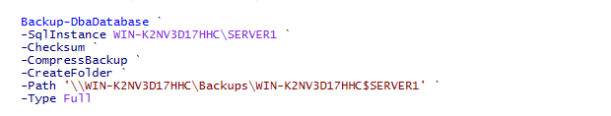
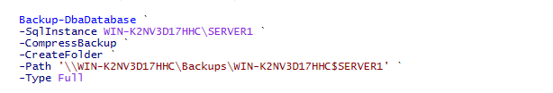
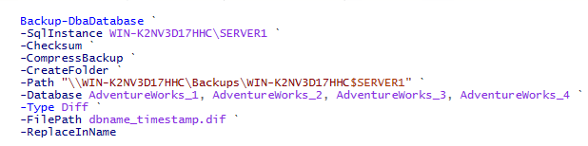
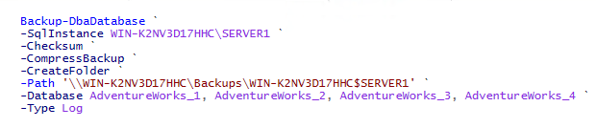
Backup-DbaDatabase

Slide 15
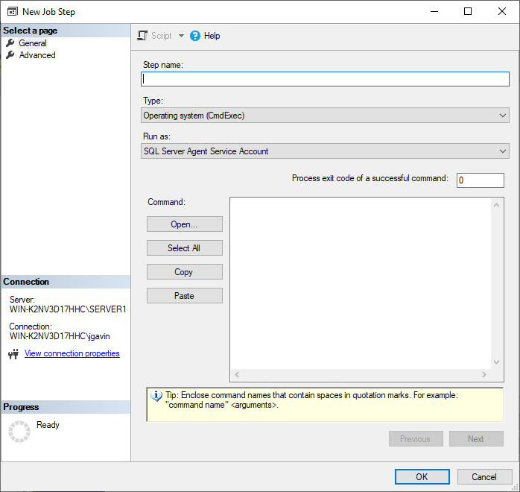

Schedule Backup-DbaDatabase

Slide 16

Test-DbaLastBackup
Restores a backup to destination
Runs DBCC CHECKDB
Drops restored test database
Repeats for each database
Outputs results
Source
Destination
Latest backup information from source

Slide 17

Requirements to Run Test-DbaLastBackup
dbatools
‘Install-Module dbatools’ from an elevated PowerShell session to install
Destination SQL Server at or above highest version you’re testing

Slide 18

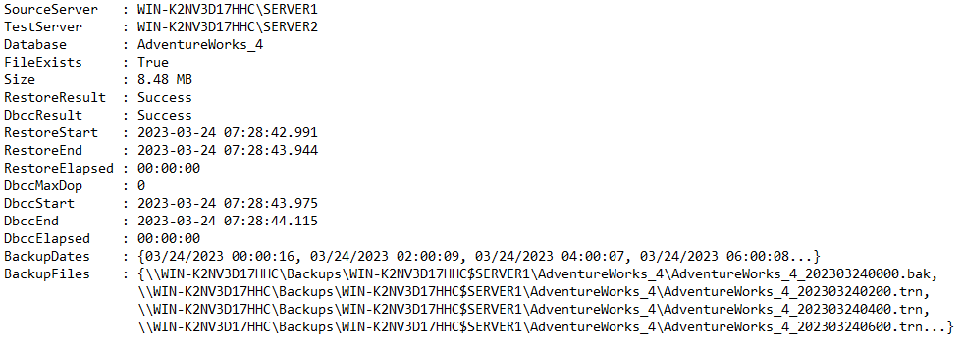
Run Test-DbaLastBackup

Slide 19




BackupValidation.ps1 Requirements
Edit server list in text file without editing script
All configuration done in variables
Run it on a schedule with a SQL Agent Job
Get an email with a .csv of the results

Slide 20
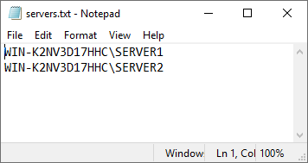
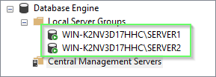
Server List

Slide 21
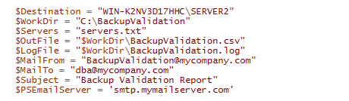
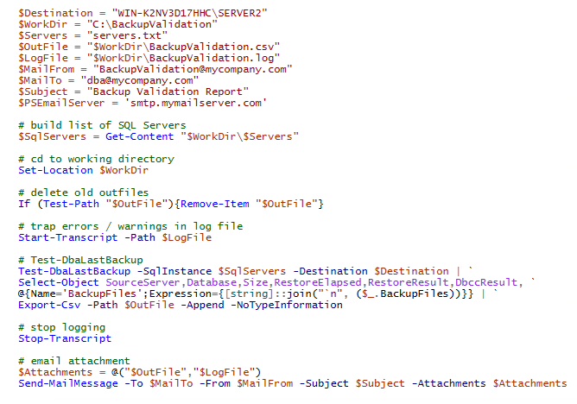
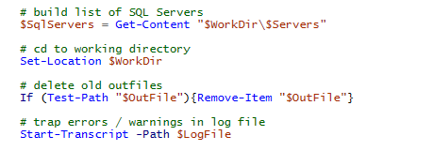

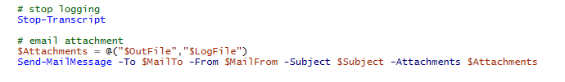
BackupValidation.ps1

Slide 22
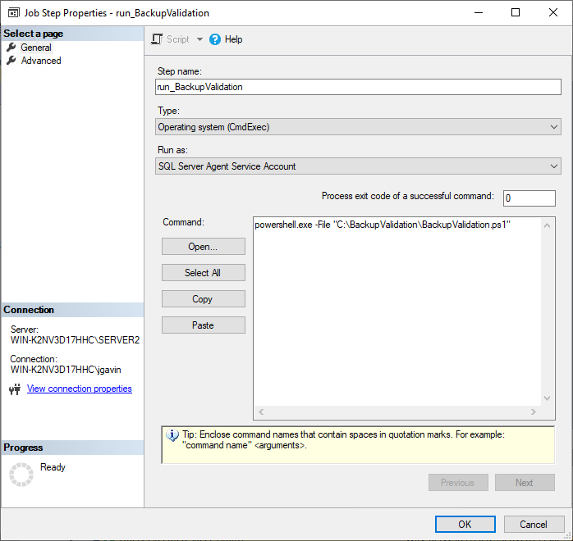
SQL Agent Job

Slide 23
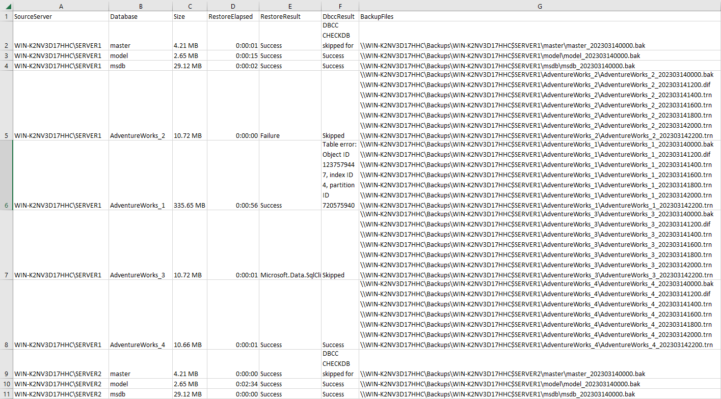
Output File
`

Slide 24
Output File

Slide 25
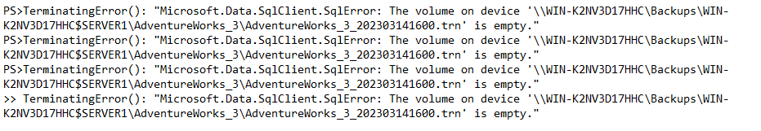
Output File

Slide 26

Output File

Slide 27
Test-DbaLastBackup Partial List of Optional Parameters
-Database -ExcludeDatabase
-IgnoreDiffBackup -IgnoreLogBackup
-NoCheck -NoDrop
-Prefix -VerifyOnly

Slide 28
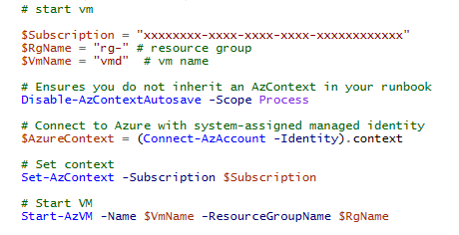
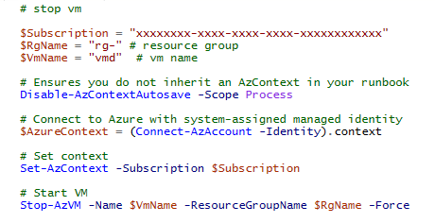
Azure Runbooks to Start / Stop VM
Notes:
- License for on-prem for just restored and DBCC?

Slide 29

Summary
Reviewed Recovery Models / Backup Types
Manually run Test-DbaLastBackup
Wrap Test-DbaLastBackup in a script to automate backup validation and reporting
How to interpret errors if they occur
Switches to further customize script
Start / stop an Azure VM
Notes:
Questions?

Slide 30

Thank You
Email: joe@joegavin.net
Twitter: @joegavin02180
LinkedIn: www.linkedin.com/in/joegavin/
GitHub: https://github.com/joegavin/presentations

